Slide 1
Compuware Integration
Sales Enablement

Slide 2
Compuware Partnership Timeline
Announce partnership in press release Oct 1st
Compuware sales enablement Oct 3rd
Huge potential opportunity
Potential questions from prospects and customers

Slide 3
Compuware focus and benefits
Compuware Bio
Large mainframe focused company
Been in business since 1973
Sells suite of mainframe development tools
Tag line:
Mainstream your mainframe with Compuware
Product Line: Topaz
Support DevOps for mainframe development
Issues Compuware Needs to Address
Their customers wants to expose the data
IBM has Z/OS Connect as a solution
Sees OpenLegacy as competitive advantage
Key takeaways
Both companies love the mainframe
Compete against IBM & doing nothing
Key thoughts:
They already are in accounts in our prospects
Products align very well

Slide 4
October Launch Announcement
"Compuware is excited to be collaborating with OpenLegacy. The new integration with Topaz empowers customers to improve their mainframe software delivery quality, velocity and efficiency within a continuously improving Topaz experience."
Chris O'Malley, CEO, Compuware
“The combination of the two vendors’ offerings gives mainframe developers unprecedented control and flexibility into their API implementations. This partnership empowers customers to incorporate mainframe applications into the modern, cloud-native world.”
Jason Bloomberg, Analyst, Intellyx

Slide 5
Why OpenLegacy should leverage the relationship
Benefits
Compuware opens doors
Trusted vendor
Involves legacy team in positive way
Easier buy-in
Timing
Eclipse plugin so no need to wait
Will be getting mutual sales contacts
Joint marketing campaigns are planned

Slide 6
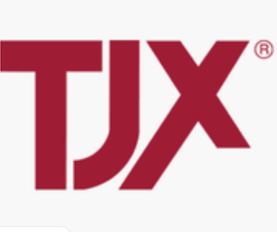
TJX, A Compuware customer – OL prospect
TJX Bio
Leading apparel and home fashions retailer
Ranked 85 in Fortune 500 companies
Heavy user of mainframes and AS/400s
7 Year plan to move to cloud
  But need APIs now
Actively develop mainframe system
  Heave usage of Compuware Topaz
  Following DevOps process
Story
Started talking to them in Spring
Talks stalled
Mentioned Integrations
  Now active interest
What they like
Plugin eases adoption
Topaz makes it easy to find metadata
(COBOL copybooks) in large system

Slide 7
5 Reasons Partnership is Important for OpenLegacy
Compuware is in most mainframe shops
  Have contacts at places we haven’t talked too
Compuware’s main competition is IBM
  IBM has Z/OS Connect
  Combined solution is better than IBMs
Compuware fills in OL’s greatest front and back-end solution gaps
  Find the metadata, e.g. COBOL copybooks, in large systems
  Helps with debugging legacy + microservices
Their products integrate into our flow very well
  Plugin as part of their Eclipse platform
Their messaging is focused DevOps for the mainframe
  Works with our DevOps messaging

Slide 8
How Will Our Partnership Work?
Compuware will explain the integration and pass leads to us
Their goal is to solve their customers problems
If you hear a prospect uses Compuware
  Leverage the integration in discussions
In mainframe discussion ask if they use Compuware
  Bring up integration

Slide 9

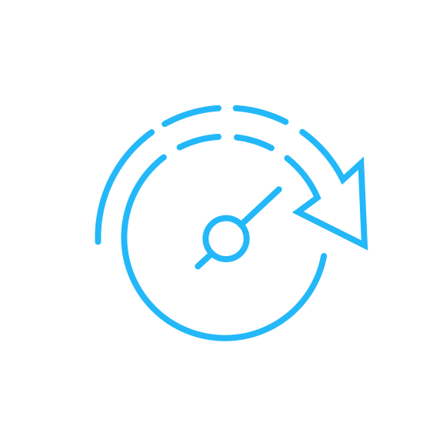

Use Case: Create Mainframe Microservices
The Initiatives:
Digital Transformation, Modernizing Mainframe Apps and DevOps
The Approach: Extend the Value of the Mainframe App by Using Microservices
Increase Velocity, Standardization & Simplicity, Faster Time-to-Value
The Process:
Plugging in microservices into your existing Topaz environment-- enabling DevOps, automatic API generation and digital services.

Slide 10


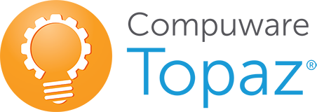







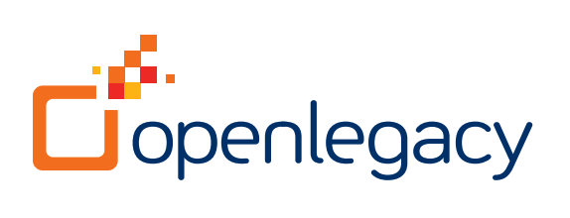
Use Case: Create Mainframe Microservices
Design Process
API Publish
On-Prem Systems
API Design
Analytics
IBM zSeries
Mainframe
Design/Develop
Security
RPC
Management
Mainframe Environments
Batch Applications
On-Line Applications
DB2
CICS
IMS
DEPLOY
Caching
Screens
EXTRACT
Testing
Dev - Ops
Performance
Mainframe
DB
Store
Notes:
What does the process look like? To start, OpenLegacy consumes metadata from the legacy system. The metadata might be something like a Cobol copybook. It might be a database schema. It might be the information about an SAP system, but basically any kind of metadata in the Legacy application can be consumed by the platform. The metadata is extracted in an AUTOMATED process, an SDK is generated and you have complete visibility to code because Java code or a Java project gets created. The SDK is a Java object and it is created within the context of an entire microservice.
Since the code is available and visible to you, you can change whatever you want and extend the functionality as mentioned before. Also, it is created JUnit models for test driven design. So, testing the microservice, both on the SDK level and on the API level is very easy and very standard. That's not a very easy thing to do in the traditional SOA stack and ESBs, but we offer a very straight forward process of just testing through JUnit testing modules.
Also, you can store the code in GIT. Basically anything you can normally do with the process of generating or moving Java code is possible in the Open Legacy platform.
The legacy application business function metadata is extracted in an Automated process, producing a code visible Java Object (no black box). In essence the SDK is a Java Object that is created within the context of the microservice. The microservices can be deployed to any environment that can support Java Microservices, these services can also be deployed optionally as JAR files (FAT).
Meaning it can be any cloud environment; it can be On-prem environment. We support OpenShift; we support Kubernetics; we support Docker. So, all those things are supported. But not only does the platform support of all of those deployment options, it also adds crosscutting concerns. So crosscutting concerns might be claimed by Analytics, Security, Management, Caching and Performance. All of those things are pre-configured so that they are created as part of the microservice and of course they can be completely customized. Again, it's a code based, code first approach so they can be completely customized to meet the organization needs.

Slide 11


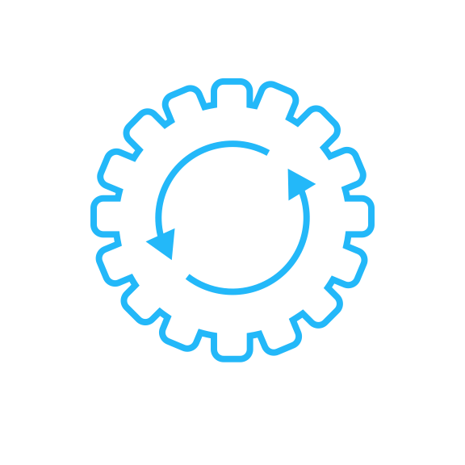

What Can We Show You?
Analyze: Topaz Workbench
Use Topaz to understand the app and analyze for best microservices approach
Identify: Runtime Visualizer Capability in Xpediter
Quickly see what programs are involved and how many times they get invoked Visualizing real execution of app; all within seconds
Design: OpenLegacy Plug-in Within Topaz
Solve integration by code generation of plain Java project exposing APIs
Debug & Test:
Step through both Java Code and Mainframe Code and generate unit and automatic regression tests.
Deploy & Manage:
Deploy full microservice solution to rich runtime environment to support scaling and high availability. Manage and monitor apps and APIs with full API Management functionality out of the box
Notes:
Analyze:
Identify:
Switching on Runtime Visualizer capability in Xpediter run will dynamically draw program calling chain in Topaz for Program Analysis.
With this, programmer/analyst can quickly see what programs are actually involved and how many times they get invoked
Also show file and databases used, visualizing real execution of app; All within seconds
Programmer/analyst can then further comprehension by stepping back through test with play controls and/or export table view for documentation (or other) purposes.
Can save days of analysis, but certainly hours

Slide 12
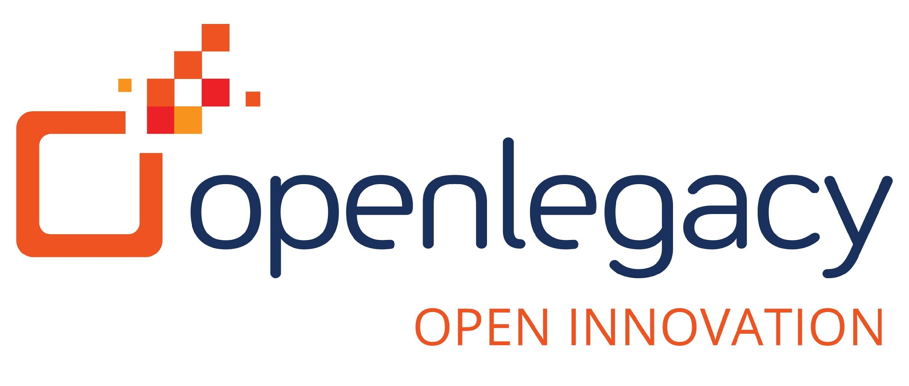
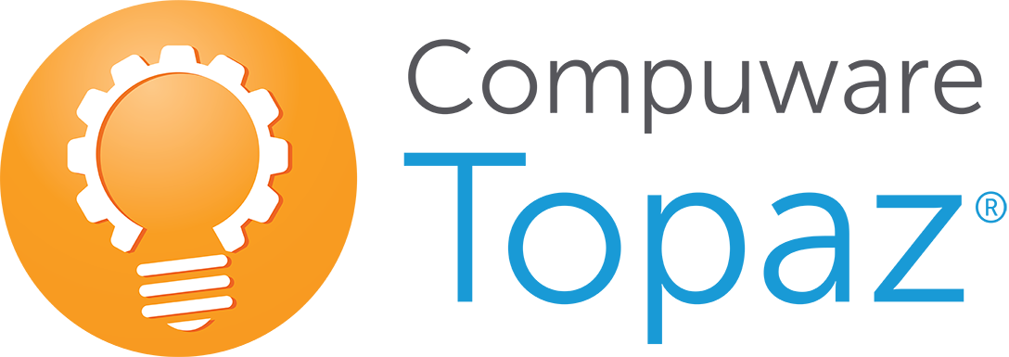
Create a Mainframe Program API
1. API Discovery Process
2. API Definition Process
3. API Deploy Process
Runtime Visualizer
OpenLegacy
OpenLegacy
Program Analysis
Xpediter
ISPW
File-AID Data Tools
Topaz for Total Test
Git
Xpediter
JUnit
Jenkins
Find code/data needed for
mobile app or open systems programs
Define API expose
to clients, generate and test API
Make API available for use
Companies fill in each others gaps
Visual to API
Mainframe to Microservices
Notes:
What does the process look like? To start, OpenLegacy consumes metadata from the legacy system. The metadata might be something like a Cobol copybook. It might be a database schema. It might be the information about an SAP system, but basically any kind of metadata in the Legacy application can be consumed by the platform. The metadata is extracted in an AUTOMATED process, an SDK is generated and you have complete visibility to code because Java code or a Java project gets created. The SDK is a Java object and it is created within the context of an entire microservice.
Since the code is available and visible to you, you can change whatever you want and extend the functionality as mentioned before. Also, it is created JUnit models for test driven design. So, testing the microservice, both on the SDK level and on the API level is very easy and very standard. That's not a very easy thing to do in the traditional SOA stack and ESBs, but we offer a very straight forward process of just testing through JUnit testing modules.
Also, you can store the code in GIT. Basically anything you can normally do with the process of generating or moving Java code is possible in the Open Legacy platform.
The legacy application business function metadata is extracted in an Automated process, producing a code visible Java Object (no black box). In essence the SDK is a Java Object that is created within the context of the microservice. The microservices can be deployed to any environment that can support Java Microservices, these services can also be deployed optionally as JAR files (FAT).
Meaning it can be any cloud environment; it can be On-prem environment. We support OpenShift; we support Kubernetics; we support Docker. So, all those things are supported. But not only does the platform support of all of those deployment options, it also adds crosscutting concerns. So crosscutting concerns might be claimed by Analytics, Security, Management, Caching and Performance. All of those things are pre-configured so that they are created as part of the microservice and of course they can be completely customized. Again, it's a code based, code first approach so they can be completely customized to meet the organization needs.

Slide 13
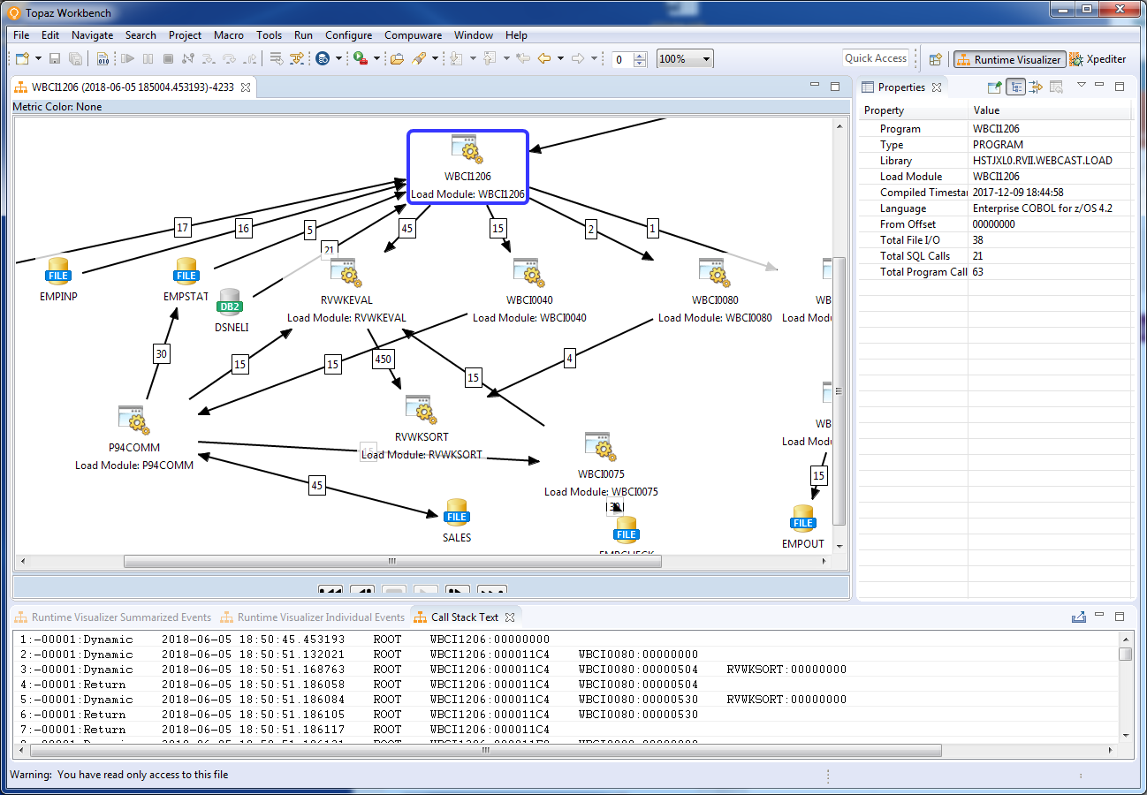
Analyze existing program
Count
of calls
Use Topaz Runtime Visualizer to review program in broader runtime context and see component architecture
Notes:
Analyze and identify candidates for exposing with API’s in Topaz

Slide 14
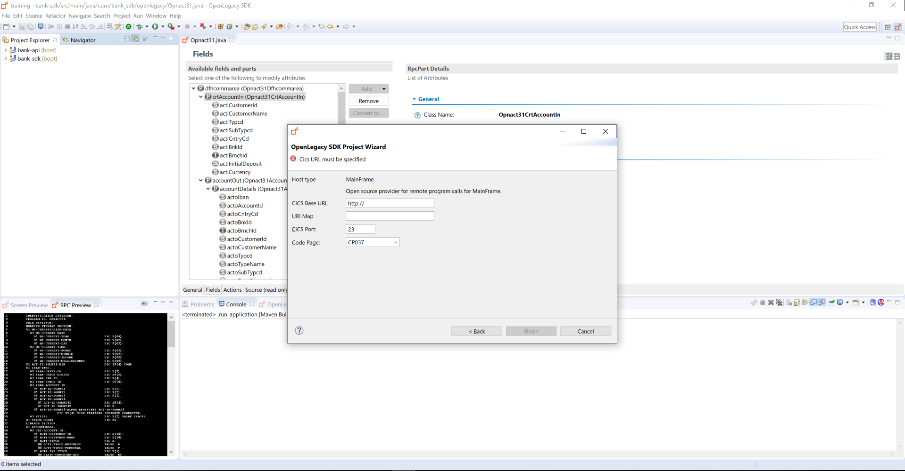
Use Program knowledge to generate Open Legacy API
Identify Program information to generate API
Notes:
Exposing legacy as Java SDK code generated through the IDE (SDK and API) and the end result of the Swagger page.

Slide 15
The Compuware & OpenLegacy Approach
Compuware + OpenLegacy
IBM
Microservices enabled solution
Open standard-based
Unlimited orchestration
Fully customizing templates
Any runtime environment
End-to-end solution
High performance
Not a Microservices product
Limited flexibility
Dependencies on integration layer
No templating support
Dependent on proprietary runtime
Low performance

Slide 16
Appendix

Slide 17
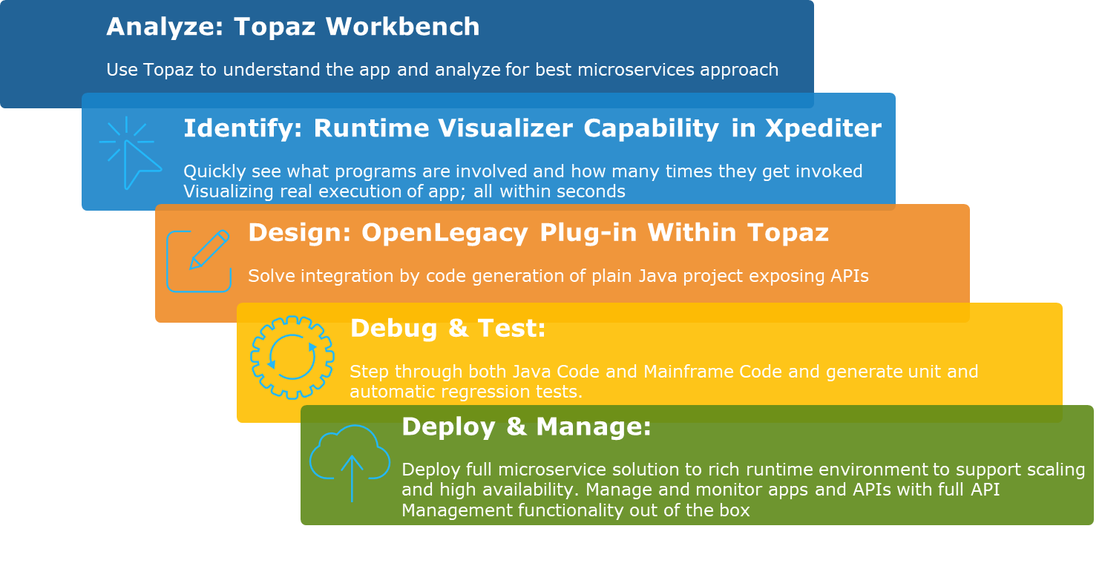
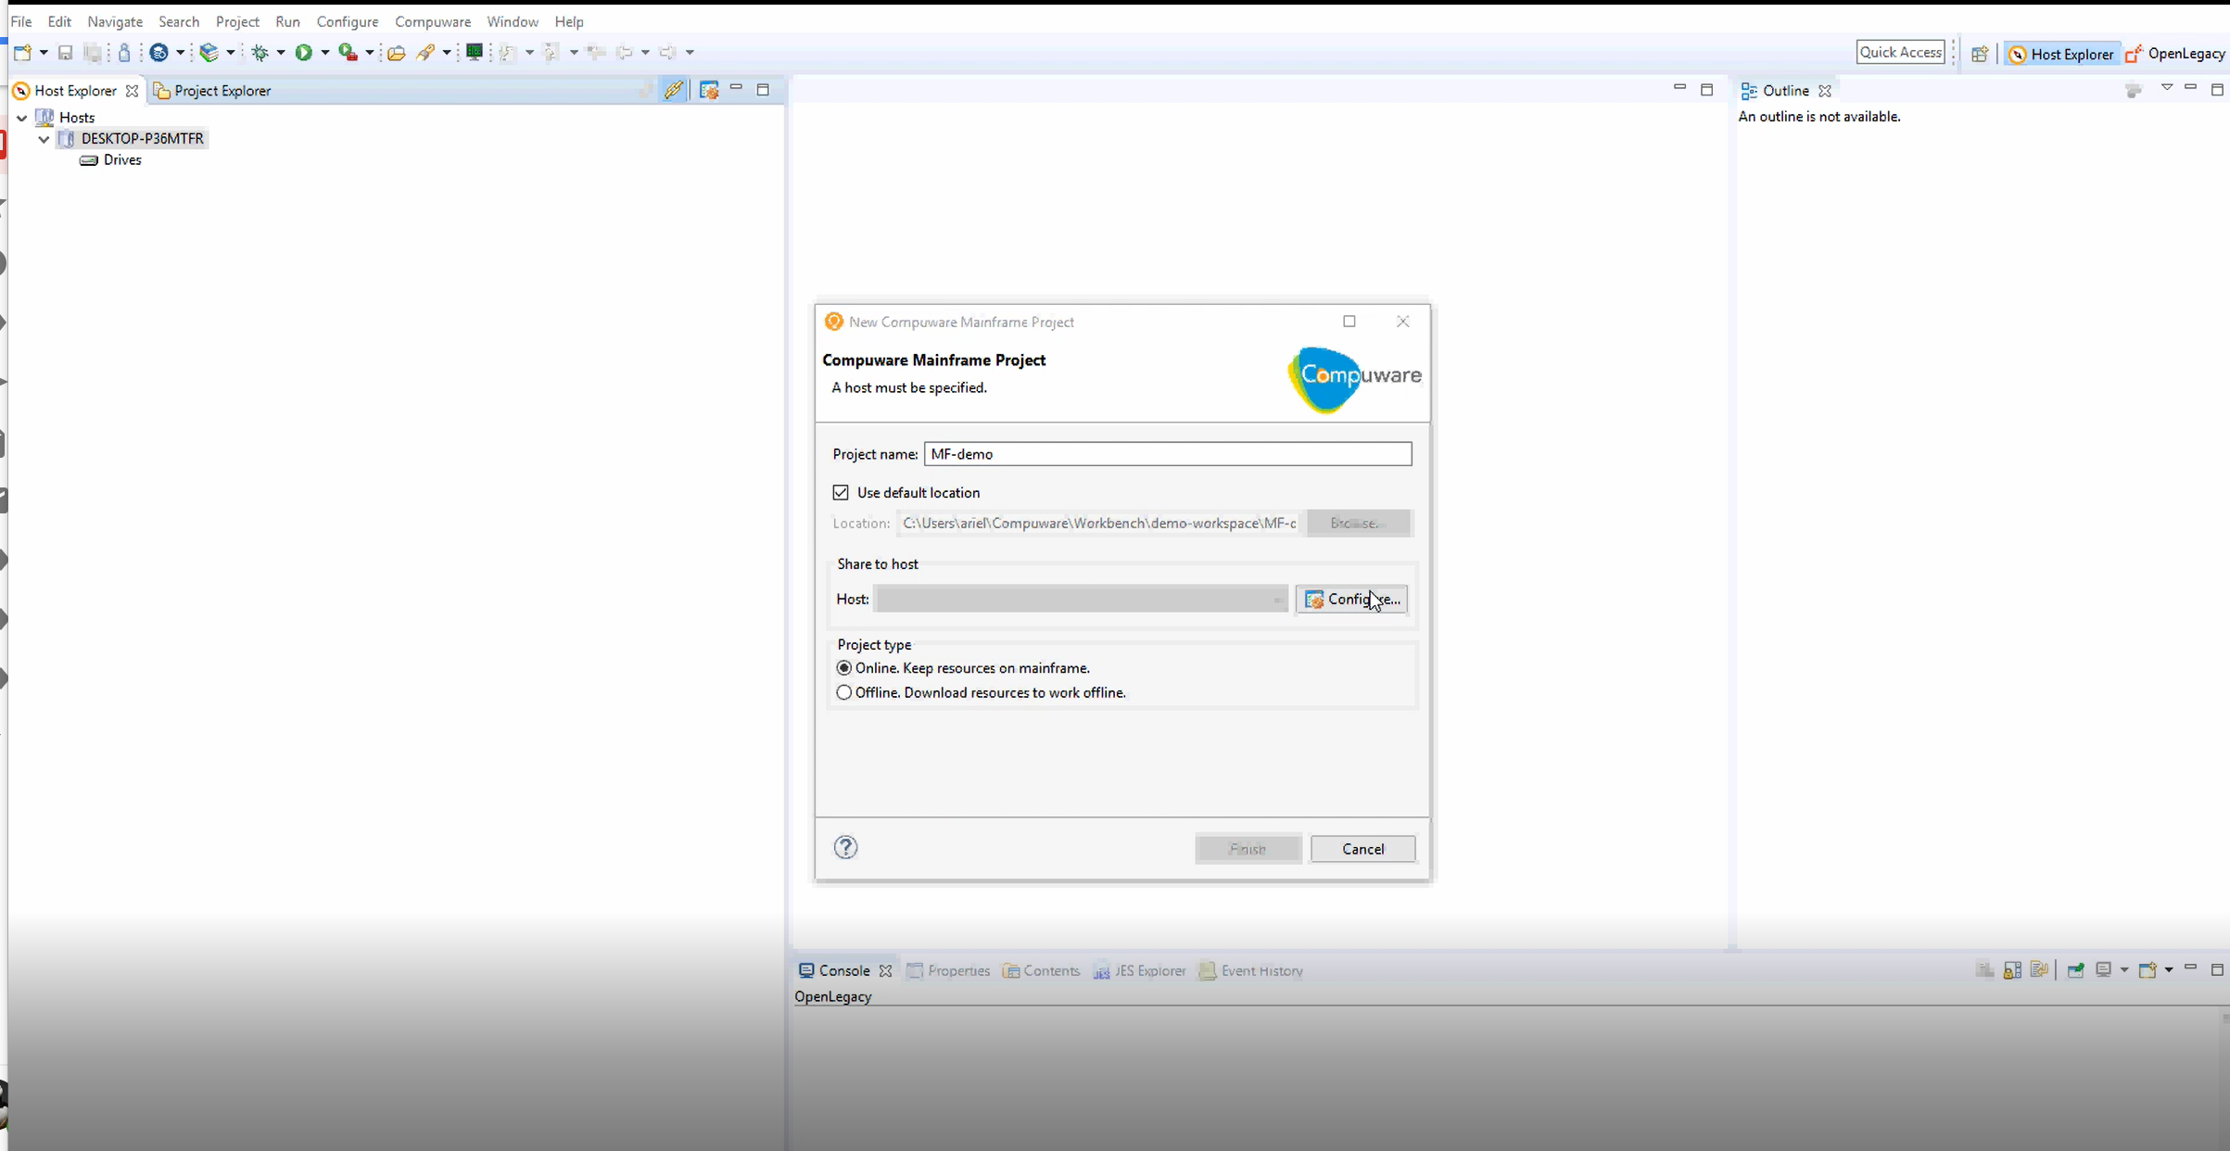
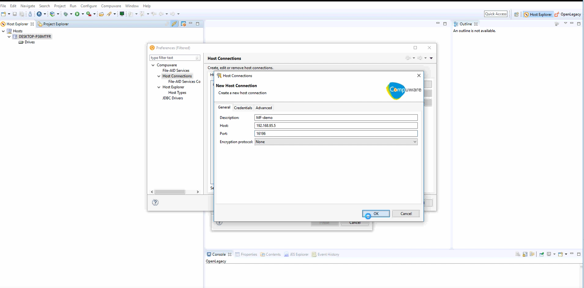
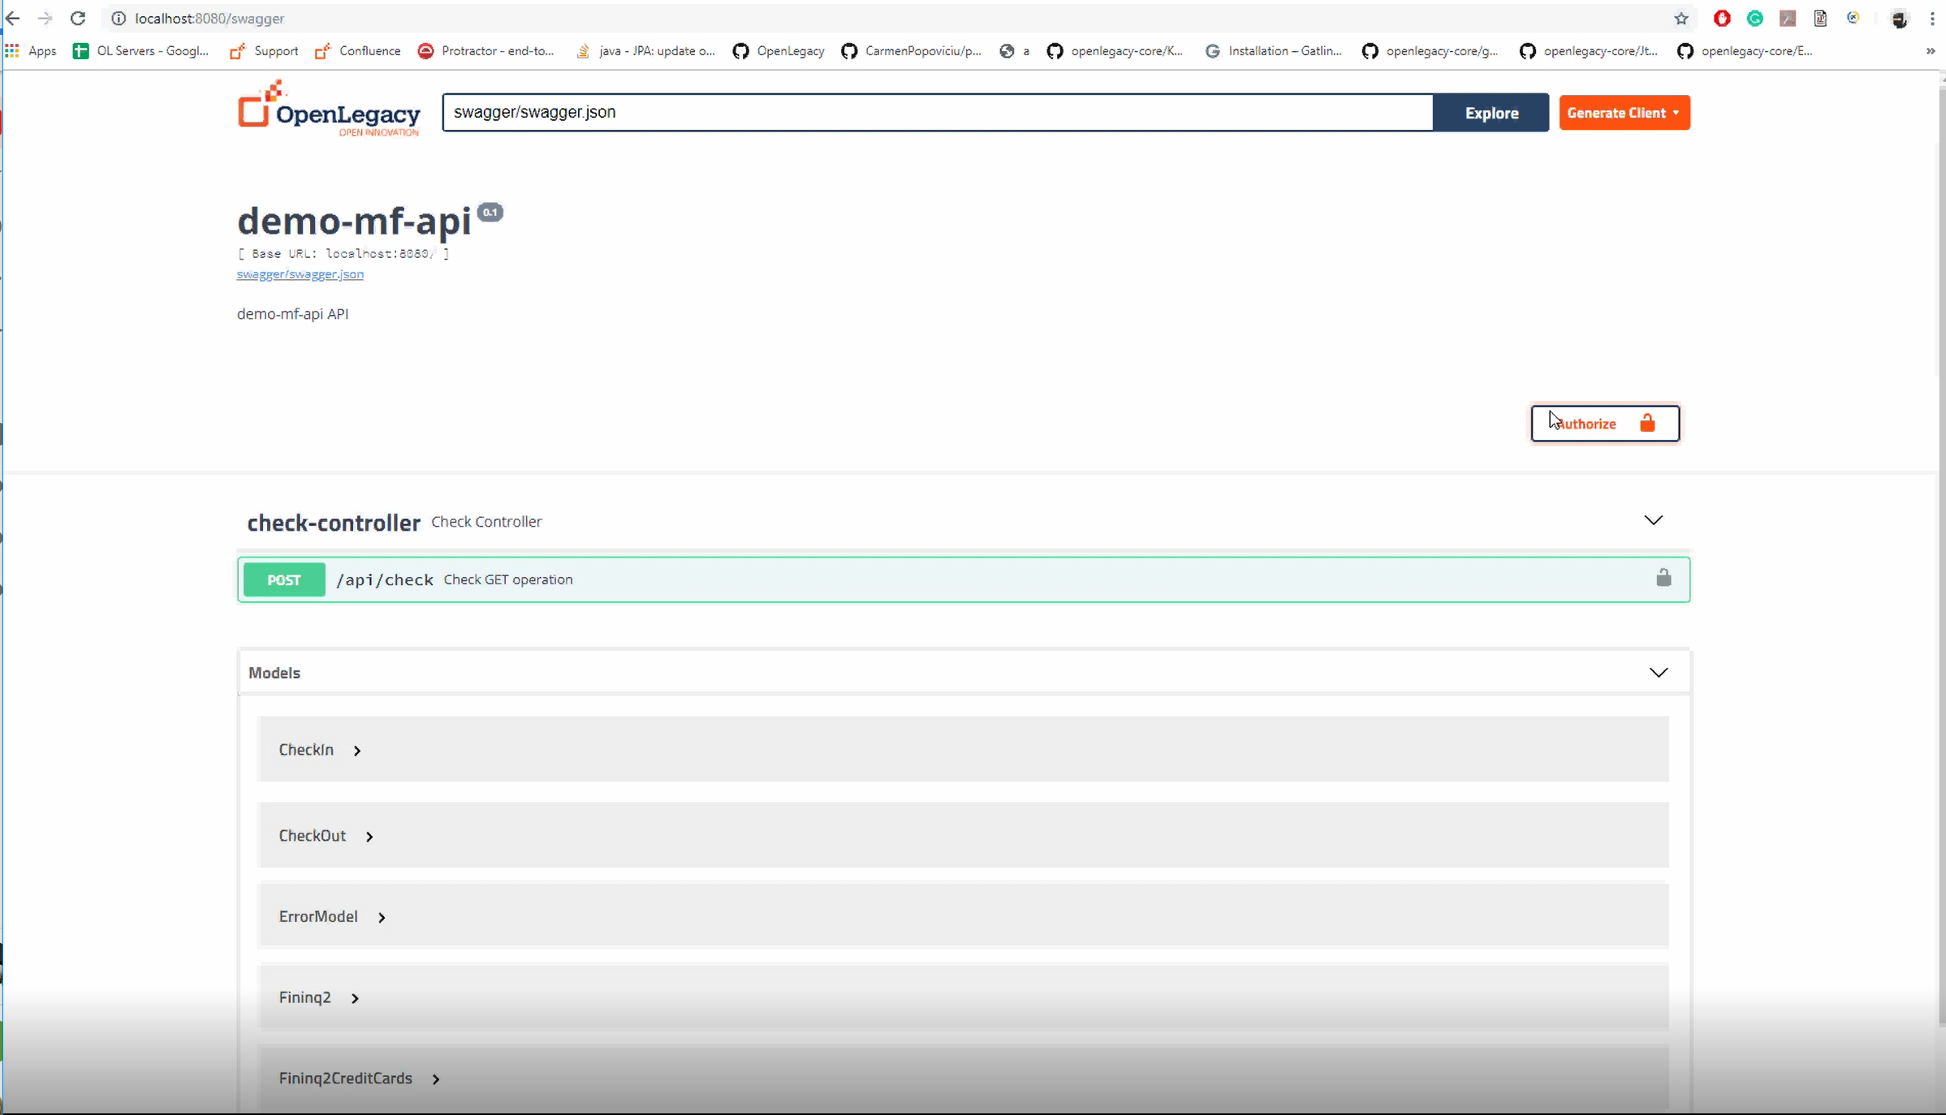
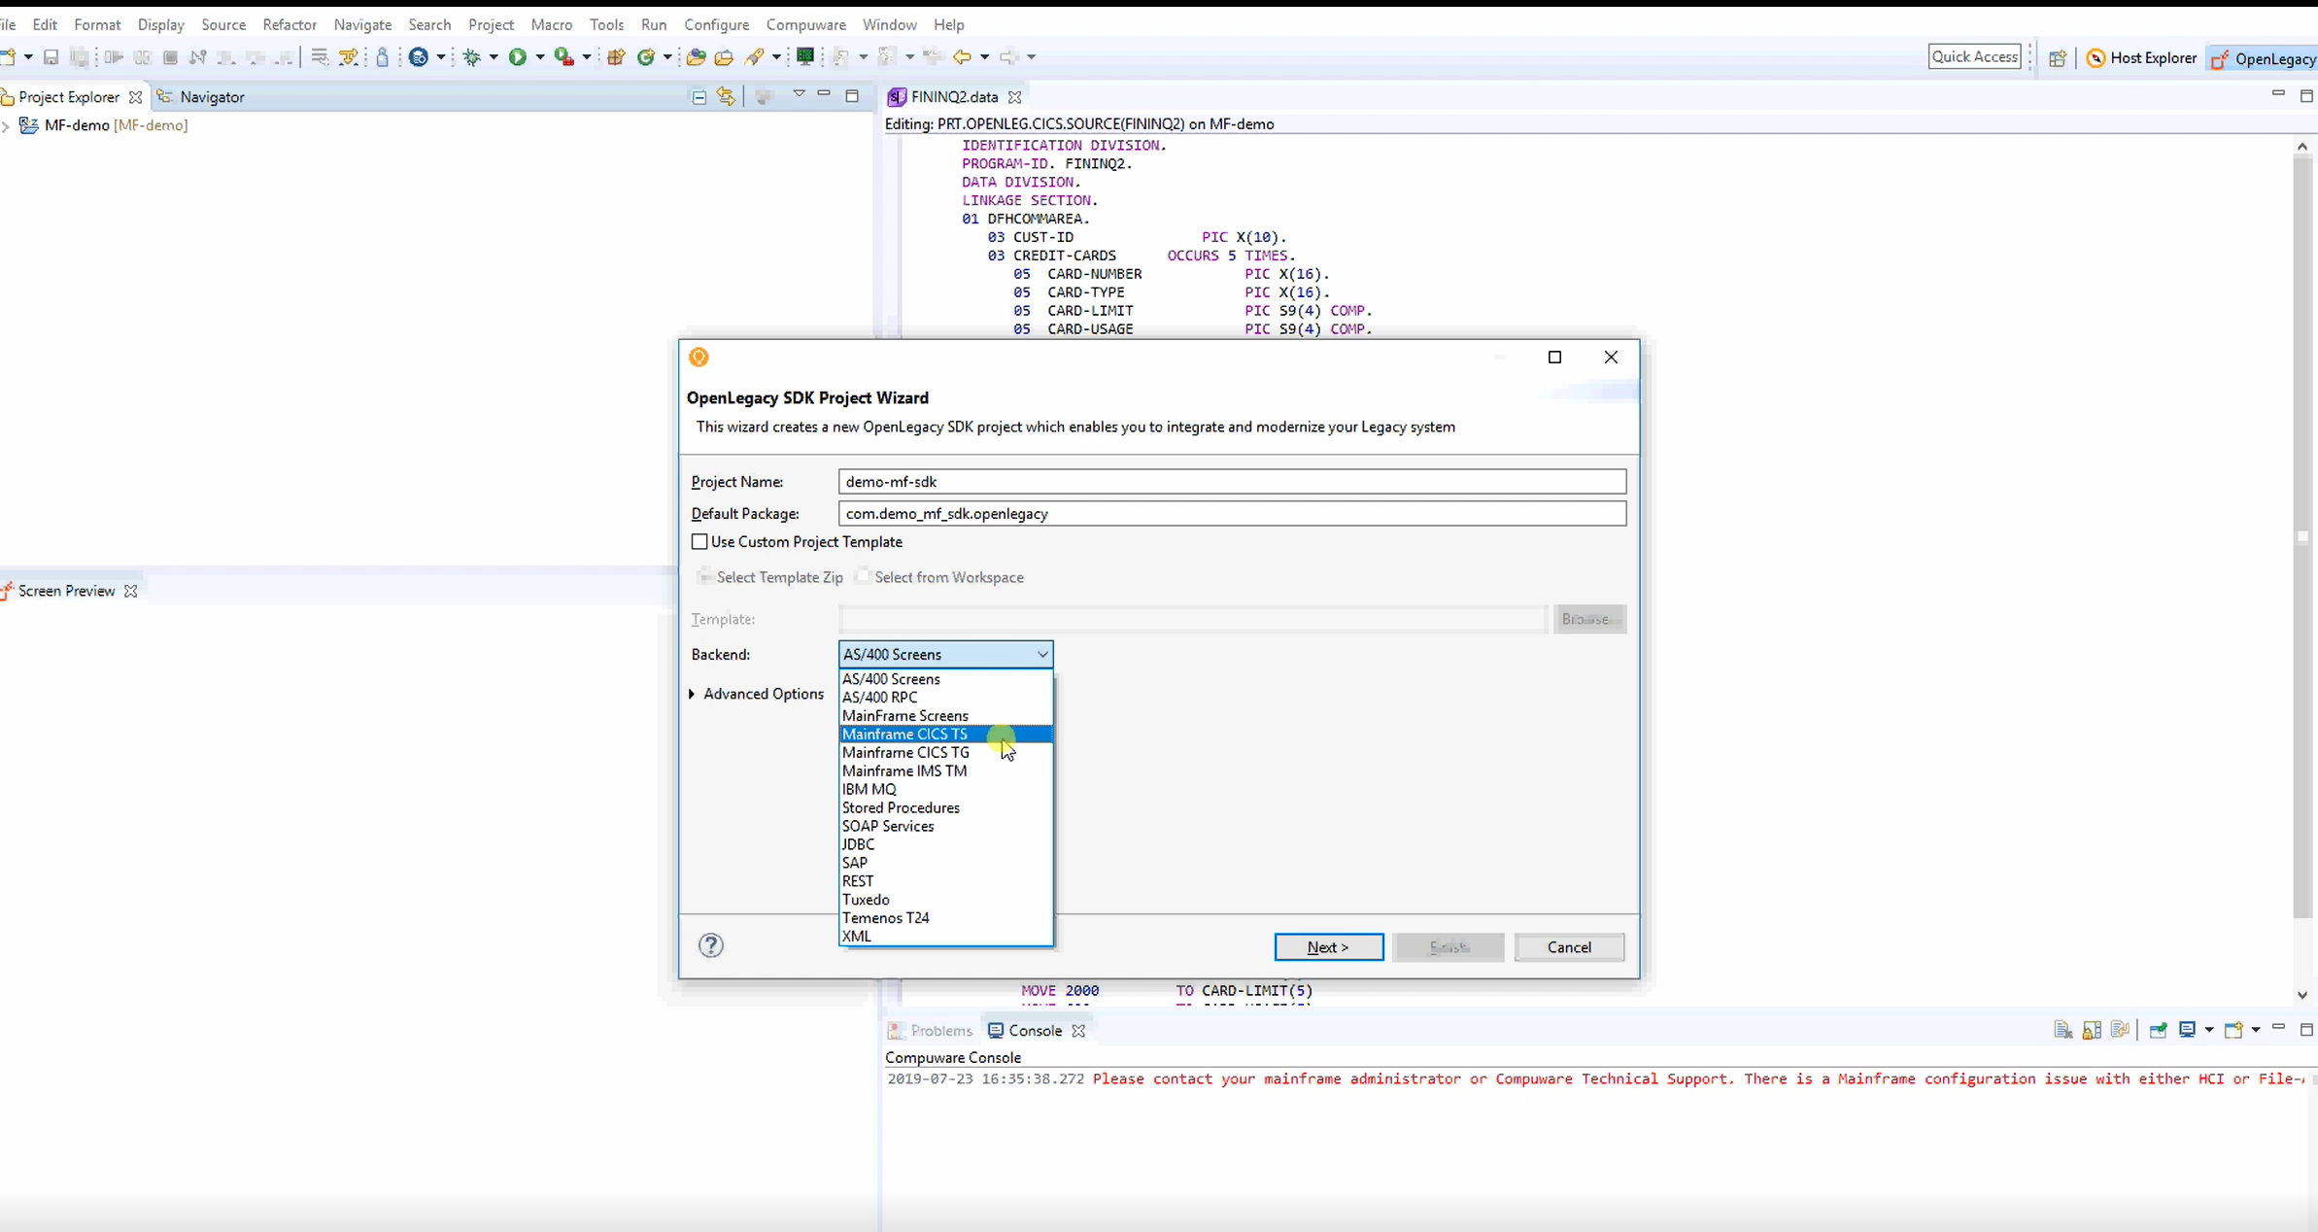
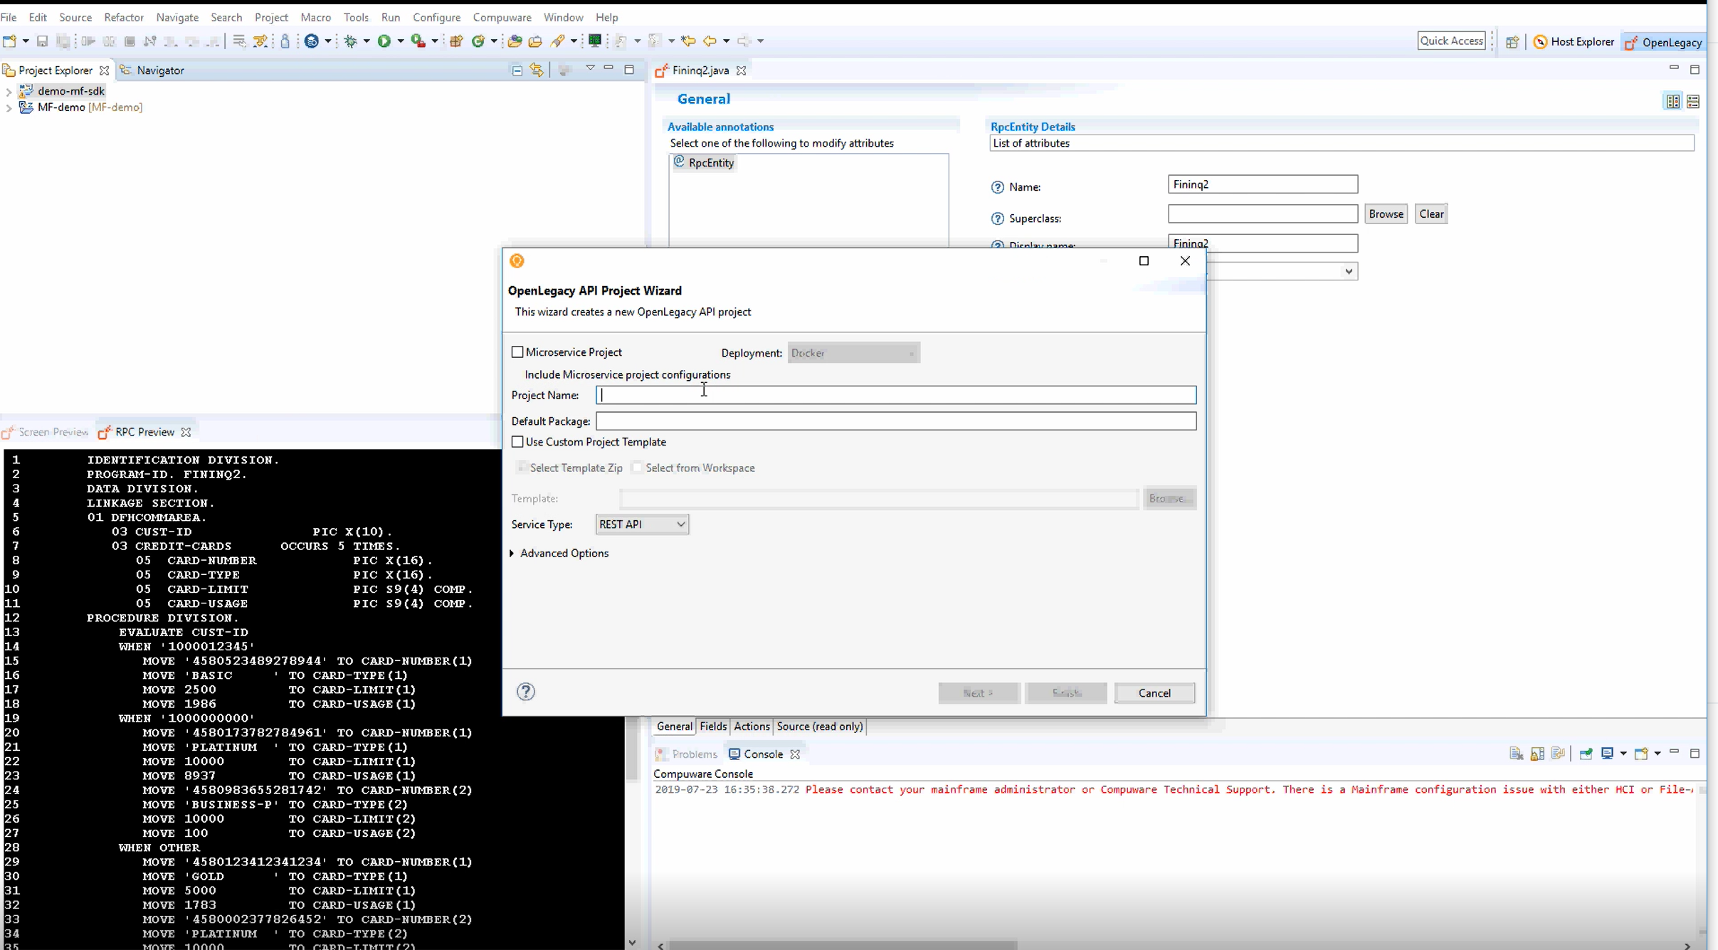
What Can We Show You?
Count
calls
Deploy & Manage:
Deploy full microservice solution to rich runtime environment to support scaling and high availability. Manage and monitor apps and APIs with full API Management functionality out of the box
Notes:
Analyze:
Identify:
Switching on Runtime Visualizer capability in Xpediter run will dynamically draw program calling chain in Topaz for Program Analysis.
With this, programmer/analyst can quickly see what programs are actually involved and how many times they get invoked
Also show file and databases used, visualizing real execution of app; All within seconds
Programmer/analyst can then further comprehension by stepping back through test with play controls and/or export table view for documentation (or other) purposes.
Can save days of analysis, but certainly hours

Slide 18
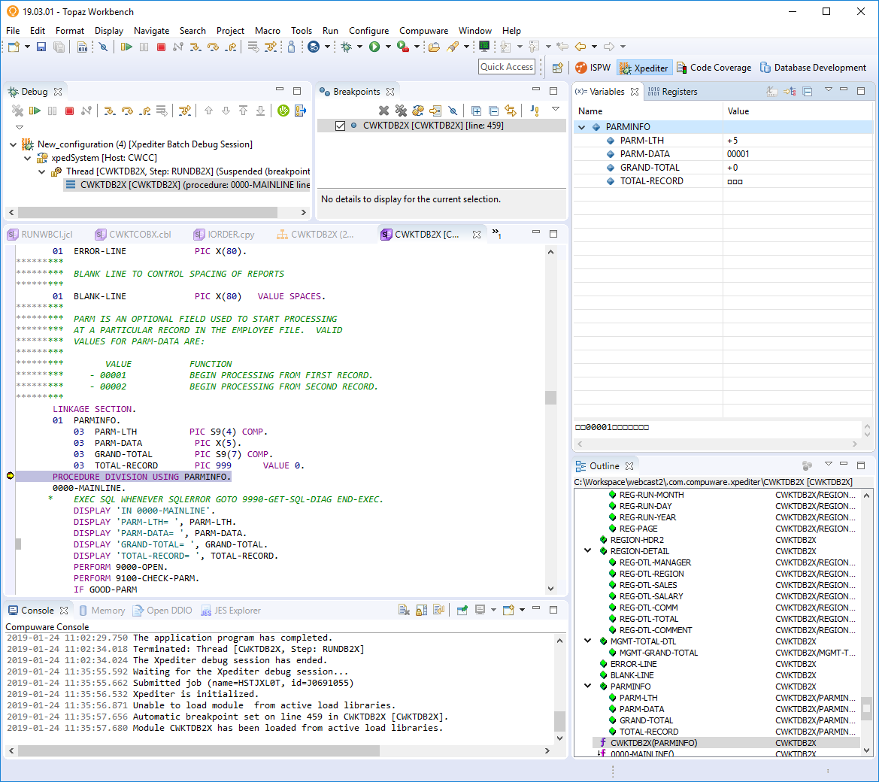
Analyze existing program
Use Xpediter to look at internal program flow and variable values
Use Topaz Program Analysis to review program outline
Notes:
Use Java Debugger and Xpediter Debugger to review existing program code. Topaz Program Analysis shows program outline and fast navigation for quick review of code.

Slide 19
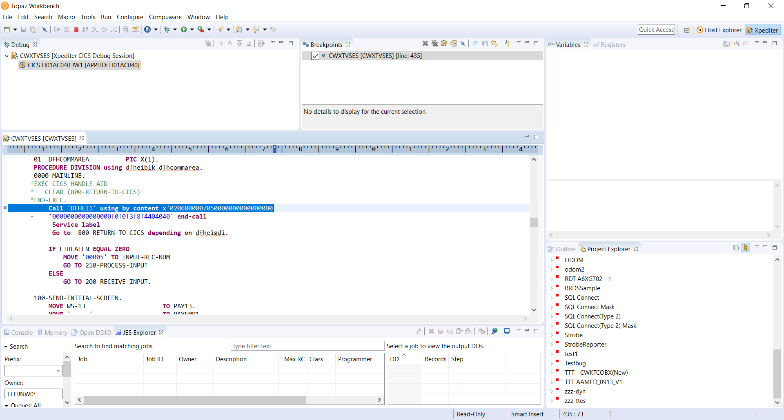
Review End to End API behavior in Eclipse and Xpediter Debuggers
Step through Java Code using Eclipse Java Debugger and Mainframe Code using Xpediter Debugger

